Slide 1

Greater Minnesota’s Economic Composition: Industries and Performance
January 2015

Slide 2
1. General themes of great recession (2008-2009) hold true in greater Minnesota

Slide 3
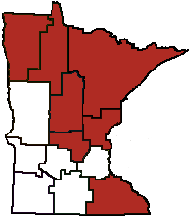
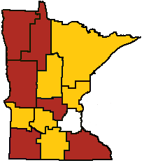
Recovery has been uneven
Change in Number of Jobs, 2008-2014
Gold = Decline
Maroon=Increase
Regions with Declines in Retail Trade Wages, After Adjusting for Inflation, 2000-2013
Spike in temporary hiring
Retail trade and construction industries suffered

Slide 4
2. manufacturing, professional and business services, and agriculture are typically the “Big 3” in terms of output

Slide 5
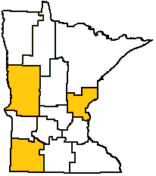
manufacturing
Regions with Increase in Manufacturing Jobs, 2003-2013

Slide 6
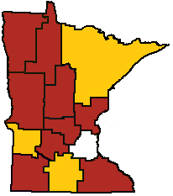
Professional and business services
Change in Number of Jobs in Professional and Business Services Industry 2003-2013
Gold = Decline
Maroon = Increase

Slide 7
agriculture

Slide 8
3. Mining remains important

Slide 9
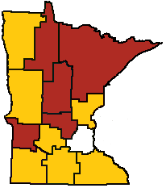
4. Health care is fastest growing industry, but….
Change in Health Care Industry’s Competitive Share, 2003-2013
Gold = Negative
Maroon = Positive

Slide 10
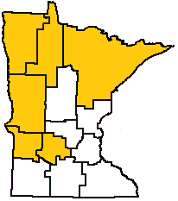
Decline in # of Jobs at Offices of Physicians
Regions with Declines in Number of Jobs at Offices of Physicians, 2003-2013

Slide 11
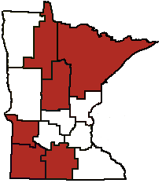
Shift in Nursing and residential care
Regions With Decline in Skilled Nursing Care and Increase in Continuing Care Retirement and Assisted Living Facilities, 2003-2013

Slide 12
5. Certain industries perform well in certain regions
Wholesale trade
Housing markets
Banking

Slide 13
Brigid Tuck, tuckb@umn.edu, 507-389-6979 http://www.extension.umn.edu/community/

